Slide 1
Map Mockup
Ver 1.0

Slide 2
Plan A

Slide 3
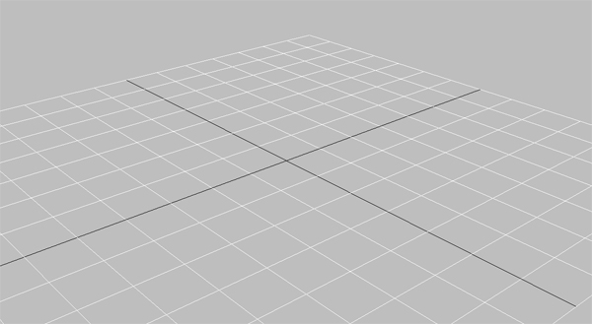
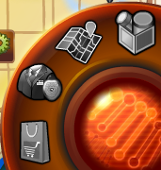
Mock-ups – Seleted Zone
Miami Map
Distinct 2
1/3
Distinct 1
Distinct 3
Distinct 4
68%
Case 12
23%
Case 11
New!
Case 10
Continue
Reopen
Play

Slide 4

Mock-ups –Case Mouse over
Miami Map
Distinct 2
1/3
Distinct 1
Distinct 3
Distinct 4
68%
Case 12
23%
Case 11
New!
Case 10
Continue
Reopen
Play

Slide 5
Mock-ups
Miami Map
Distinct 2
4/5
Distinct 1
Distinct 3
Distinct 4
68%
Case 12
23%
Case 11
New!
Case 10
New!
Case 11
Finished!
Case 12
09:59
Case 13
Continue
Reopen
Play
Hire
Collect!
Instant

Slide 6
Mock-ups –mouse over other zone
Miami Map
Distinct 2
4/5
Distinct 1
Distinct 1
2/3
Distinct 4
68%
Case 12
23%
Case 11
New!
Case 10
Continue
Reopen
Play

Slide 7
Mock-ups –Jump to another zone
Miami Map
Distinct 3
2/2
Distinct 1
Distinct 2
Distinct 4
11%
Case 6
15%
Case 7
Reopen
Reopen

Slide 8
Plan B

Slide 9
Mock-ups – Seleted Zone
Miami Map
Distinct 3
1/3
Case 3
Case 1
Distinct 1
Case 2
Distinct 3
Distinct 4

Slide 10

Mock-ups – Seleted Zone
Miami Map
Distinct 3
1/3
Case 1
Clowning Around
Case 3
Distinct 1
Case 2
New Case!
Distinct 3
Distinct 4

Slide 11
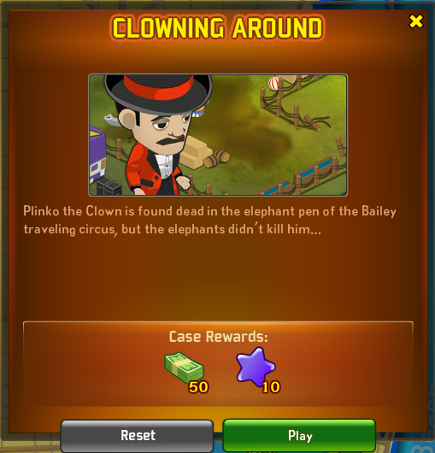
Mock-ups – Seleted Zone
Miami Map
Distinct 3
1/3
Case 3
Distinct 1
Case 2
Distinct 3
Distinct 4

Slide 12
Mock-ups – Seleted Zone
Miami Map
Distinct 2
1/3
Case 2
Case 3
Case 1
Clowning Around
Distinct 1
68%
Distinct 3
Distinct 4

Slide 13
Mock-ups – Seleted Zone
Miami Map
Distinct 2
1/3
Case 3
Case 1
Distinct 1
Case 2
Distinct 3
Distinct 4

Slide 14
Mock-ups – Seleted Zone
Miami Map
Distinct 2
1/3
Case 3
Case 1
Distinct 1
Distinct 3
Case 2
2/3
Distinct 4

Slide 15
Mock-ups – Seleted Zone
Miami Map
Distinct 3
2/2
Distinct 1
Case 4
Case 5
Distinct 2
Distinct 4

